Slide 1
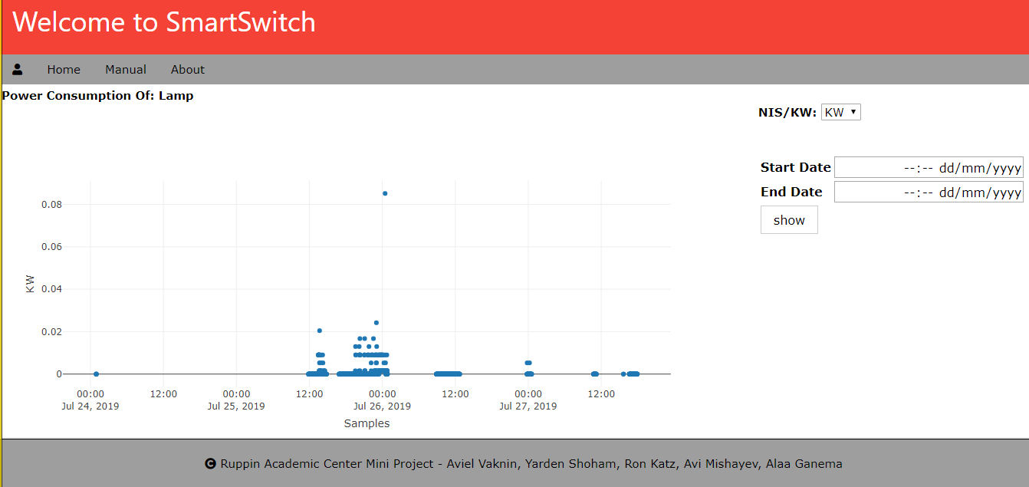
Show Power Consumption Page
In this page we can see power consumption of the device we entered with it this page. When we arrive this page
a graph will be display to the user that show the power consumption in KW

Slide 2
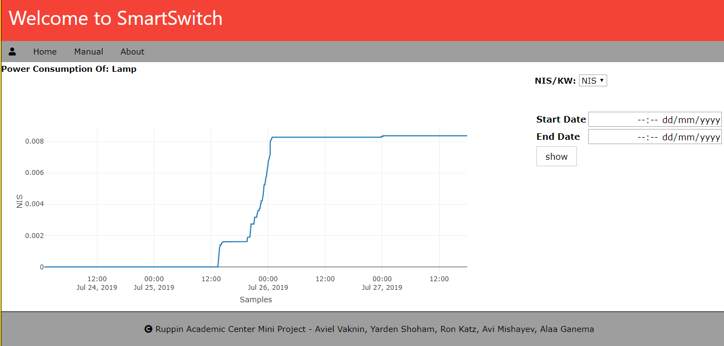
Show Power Consumption Page
In this page we can see how much did it cost using this device according to the power and the cost of one KW

